Slide 1
Data and Features, Supervised Learning by Computing Distances
CS771: Introduction to Machine Learning
Piyush Rai

Slide 2
Announcements
Python + NumPy refresher: Aug 5 (Saturday), 6pm, RM-101
Conducted by CSE PhD students Avideep and Soumya
Also plan to have a maths refresher next week (an extra session)
Add-drop requests: Will be cleared by noon tomorrow (Aug 4)

Slide 3

Data and Features
Features represent semantics of the inputs. Being able to extract good features is key to the success of ML algos
ML algos require a numeric feature representation of the inputs
Features can be obtained using one of the two approaches
Approach 1: Extracting/constructing features manually from raw inputs
Approach 2: Learning the features from raw inputs
Approach 1 is what we will focus on primarily for now
Approach 2 is what is followed in Deep Learning algorithms (will see later)
Approach 1 is not as powerful as Approach 2 but still used widely

Slide 4
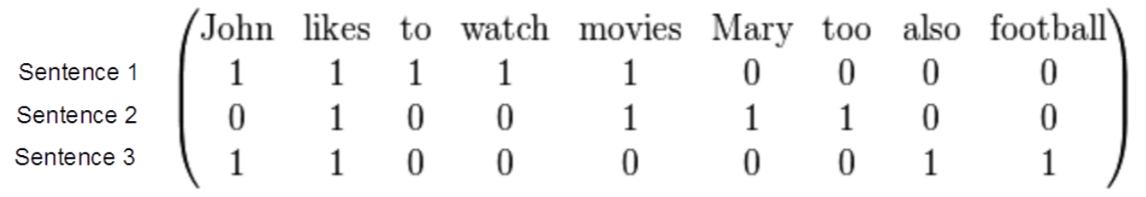
Example: Feature Extraction for Text Data
Other similar approaches such as TF-IDF (term frequency, inverse document frequency) are also widely used
Consider some text data consisting of the following sentences:
John likes to watch movies
Mary likes movies too
John also likes football
Want to construct a feature representation for these sentences
Here is a “bag-of-words” (BoW) feature representation of these sentences
Each sentence is now represented as a binary vector (each feature is a binary value, denoting presence or absence of a word). BoW is also called “unigram” rep.
BoW is just one of the many ways of doing feature extraction for text data. Not the most optimal one, and has various flaws (can you think of some?), but often works reasonably well

Slide 5
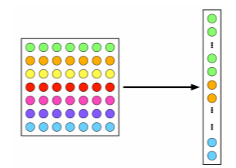

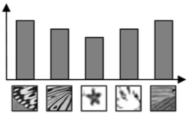
Example: Feature Extraction for Image Data
A very simple feature extraction approach for image data is flattening
Histogram of visual patterns is another popular feature extr. method for images
Many other manual feature extraction techniques developed in computer vision and image processing communities (SIFT, HoG, and others)
Flattening and histogram based methods destroy the spatial information in the image but often still work reasonably well
7x7 image
(49 pixels)
Vector of pixel
intensities
Bar heights in the histogram denote how the frequency of occurrence of each of the patterns in the given image (this vector of frequencies can be used as the extracted feature vector for this image)
Suppose these are typical patterns in the images in the dataset
Pic credit: cat.uab.cat/Research/object-recognition

Slide 6
Feature Selection
Not all the extracted features may be relevant for learning the model (some may even confuse the learner)
Feature selection (a step after feature extraction) can be used to identify the features that matter, and discard the others, for more effective learning
Many techniques exist – some based on intuition, some based on algorithmic principles (will visit feature selection later)
More common in supervised learning but can also be done for unsup. learning
Age
Gender
Height
Weight
Eye color
Calculating BMI from this data doesn’t require ML but this simple example is just to illustrate the idea of feature selection ☺
Body-mass index (BMI)

Slide 7
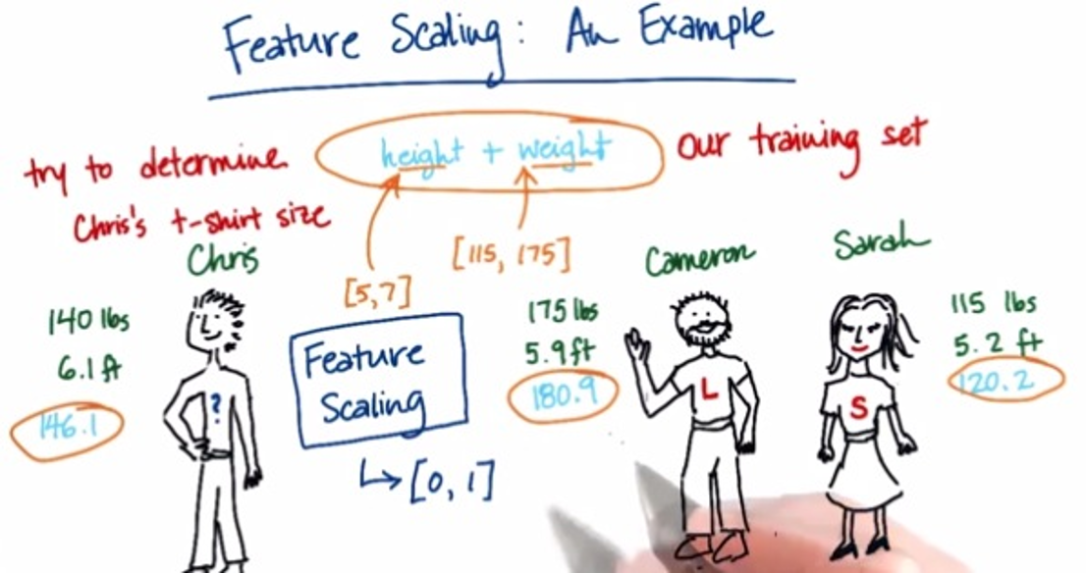
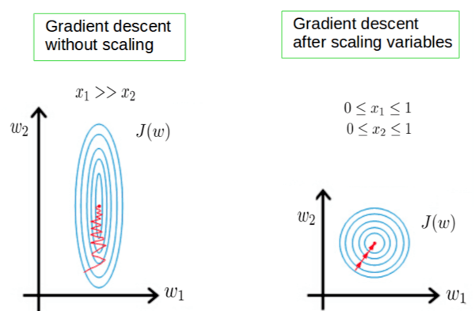
Some More Postprocessing: Feature Scaling
Even after feature selection, the features may not be on the same scale
This can be problematic when comparing two inputs – features that have larger scales may dominate the result of such comparisons
Therefore helpful to standardize the features (e.g., by bringing all of them on the same scale such as between 0 to 1)
Also helpful for stabilizing the optimization techniques used in ML algos
Pic credit: https://becominghuman.ai/demystifying-feature-scaling-baff53e9b3fd, https://stackoverflow.com/

Slide 8
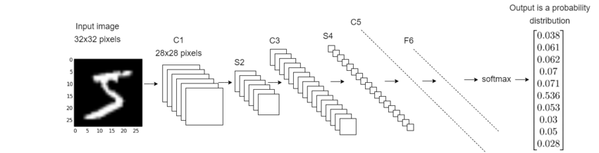
Deep Learning: An End-to-End Approach to ML
Deep Learning = ML with automated feature learning from the raw inputs
Feature extraction part is automated via the feature learning module
Classification Model Learning
Feature Learning Module
(one or more layers)
Raw Input
Learned Features
(penultimate layer)
Pic an adaptation of the original from: https://deepai.org/

Slide 9
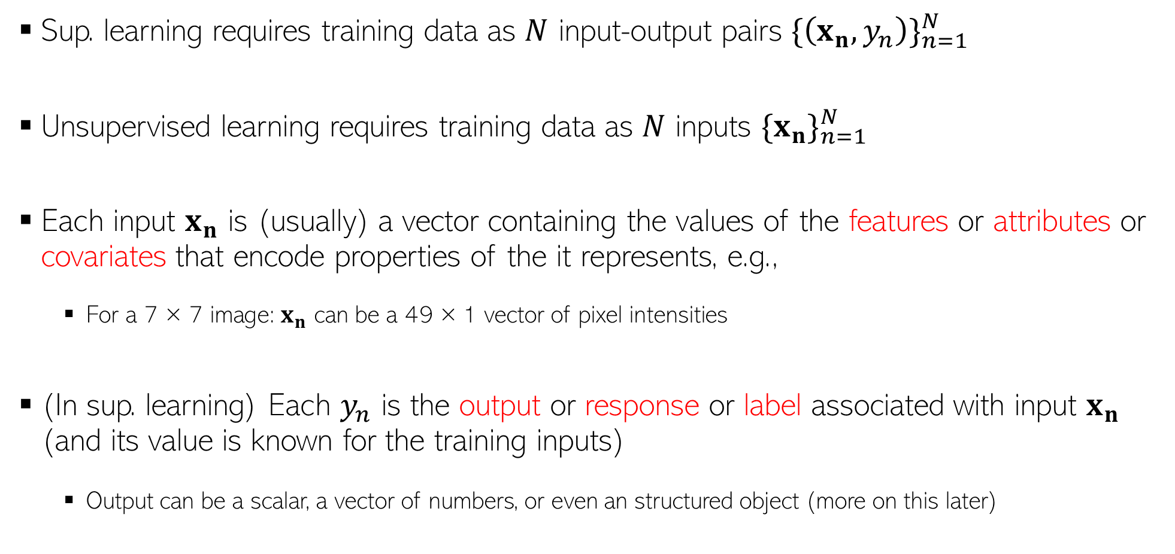
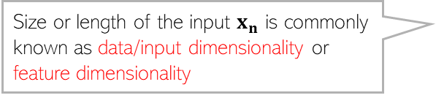
Some Notation/Nomenclature/Convention
Sup. learning requires training data as $N$ input-output pairs ${\{\left(x_{n},y_{n}\right)\}}_{n=1}^{N}$
Unsupervised learning requires training data as $N$ inputs ${\{x_{n}\}}_{n=1}^{N}$
Each input $x_{n}$ is (usually) a vector containing the values of the features or attributes or covariates that encode properties of the it represents, e.g.,
For a 7 × 7 image: $x_{n}$ can be a 49 × 1 vector of pixel intensities
(In sup. learning) Each $y_{n}$ is the output or response or label associated with input $x_{n}$ (and its value is known for the training inputs)
Output can be a scalar, a vector of numbers, or even an structured object (more on this later)
RL and other flavors of ML problems also use similar notation
Size or length of the input $x_{n}$ is commonly known as data/input dimensionality or feature dimensionality

Slide 10
Types of Features and Types of Outputs
Features as well as outputs can be real-valued, binary, categorical, ordinal, etc.
Real-valued: Pixel intensity, house area, house price, rainfall amount, temperature, etc
Binary: Male/female, adult/non-adult, or any yes/no or present/absent type value
Categorical/Discrete: Zipcode, blood-group, or any “one from a finite many choices“ value
Ordinal: Grade (A/B/C etc.) in a course, or any other type where relative values matter
Often, the features can be of mixed types (some real, some categorical, some ordinal, etc.)

Slide 11
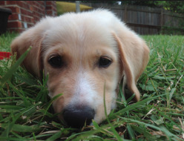
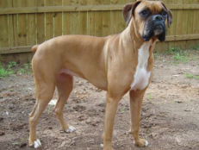
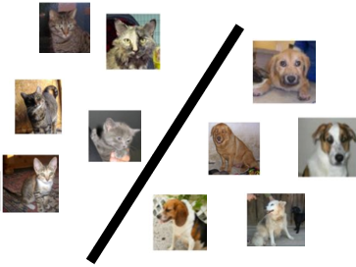
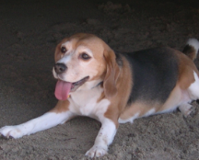
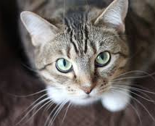




Supervised Learning
Labeled
Training
Data
“dog”
Supervised Learning
Algorithm
“dog”
“cat”
“cat”
Cat vs Dog
Prediction model
“cat”
Important: In ML (not just sup. learning but also unsup. and RL), training and test datasets should be “similar” (we don’t like “out-of-syllabus” questions in exams ☺)
Predicted Label
(cat/dog)
A test image
In the above example, it means that we can’t have test data with BnW images or sketches of cats and dogs
Cat vs Dog
Prediction model
Does it mean ML is useless if this assumption is violated?
Of course not. ☺ Many ML techniques exist to handle such situations (a bit advanced but will touch upon those later)
More formally, the train and test data distributions should be the same
Will give you just the names for now – domain adaptation, covariate shift, transfer learning, etc

Slide 12
Some Types of Supervised Learning Problems
Consider building an ML module for an e-mail client
Some tasks that we may want this module to perform
Predicting whether an email of spam or normal: Binary Classification
Predicting which of the many folders the email should be sent to: Multi-class Classification
Predicting all the relevant tags for an email: Tagging or Multi-label Classification
Predicting what’s the spam-score of an email: Regression
Predicting which email(s) should be shown at the top: Ranking
Predicting which emails are work/study-related emails: One-class Classification
These predictive modeling tasks can be formulated as supervised learning problems
Today: A very simple supervised learning model for binary/multi-class classification
This model doesn’t require any fancy maths – just computing means and distances

Slide 13
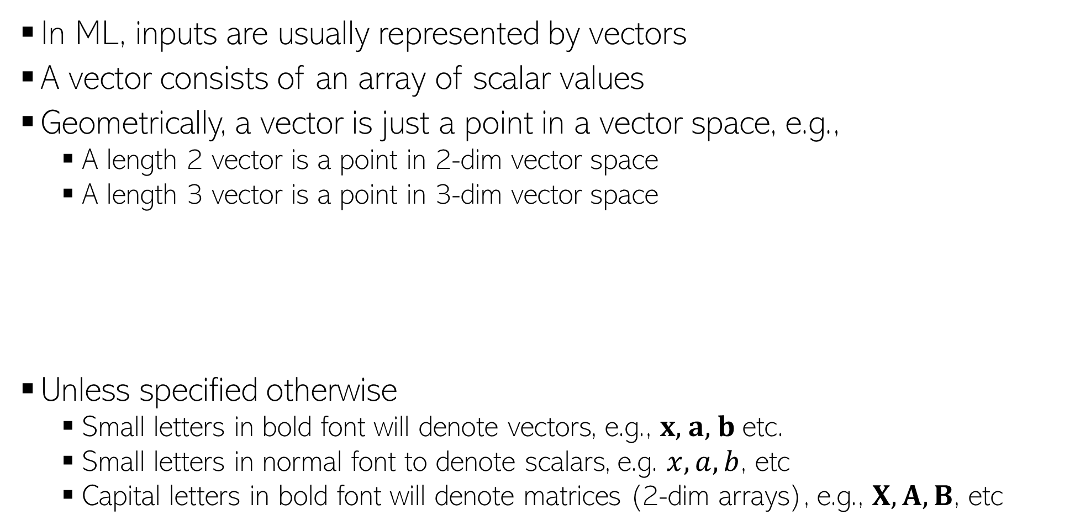
Some Notation and Conventions
In ML, inputs are usually represented by vectors
A vector consists of an array of scalar values
Geometrically, a vector is just a point in a vector space, e.g.,
A length 2 vector is a point in 2-dim vector space
A length 3 vector is a point in 3-dim vector space
Unless specified otherwise
Small letters in bold font will denote vectors, e.g., $x$, $a$, $b$ etc.
Small letters in normal font to denote scalars, e.g. $x, a, b$, etc
Capital letters in bold font will denote matrices (2-dim arrays), e.g., $X, A, B$, etc
0.5 | 0.3 | 0.6 | 0.1 | 0.2 | 0.5 | 0.9 | 0.2 | 0.1 | 0.5
Likewise for higher dimensions, even though harder to visualize
(0.5,0.3)
(0.5,0.3,0.6)
0.5 | 0.3 | 0.6
0.5 | 0.3

Slide 14
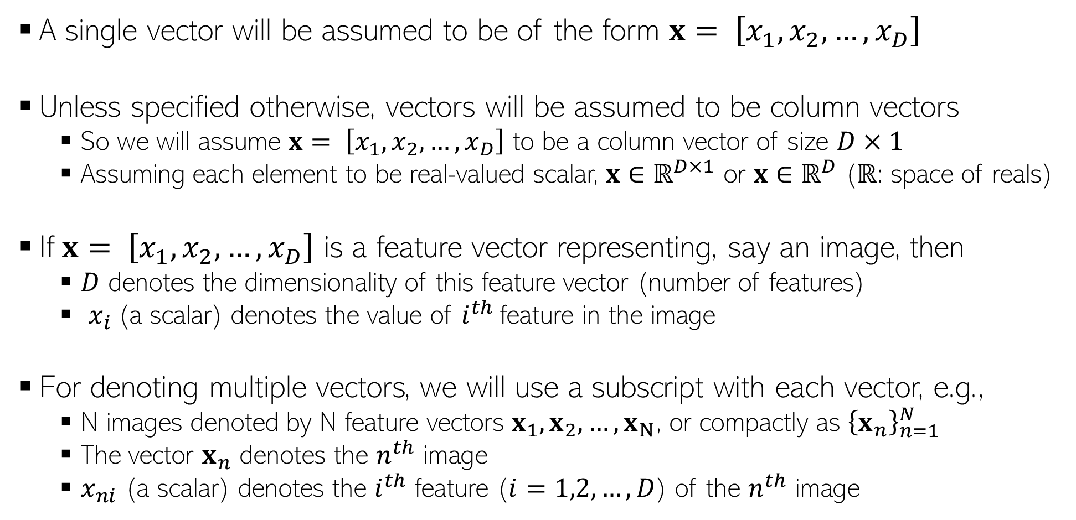
Some Notation and Conventions
A single vector will be assumed to be of the form $x= \left[x_{1},x_{2},…,x_{D}\right]$
Unless specified otherwise, vectors will be assumed to be column vectors
So we will assume $x= \left[x_{1},x_{2},…,x_{D}\right]$ to be a column vector of size $D×1$
Assuming each element to be real-valued scalar, $x$ $∈ℝ^{D×1}$ or $x$ $∈ℝ^{D}$ ($ℝ$: space of reals)
If$x= \left[x_{1},x_{2},…,x_{D}\right]$ is a feature vector representing, say an image, then
$D$ denotes the dimensionality of this feature vector (number of features)
$x_{i}$(a scalar) denotes the value of $i^{th}$feature in the image
For denoting multiple vectors, we will use a subscript with each vector, e.g.,
N images denoted by N feature vectors $x_{1}, x_{2},…,x_{N}$, or compactly as ${\left\{x_{n}\right\}}_{n=1}^{N}$
The vector $x_{n}$ denotes the $n^{th}$ image
$x_{ni}$ (a scalar) denotes the $i^{th}$ feature ($i=1,2,…,D$) of the $n^{th}$ image

Slide 15
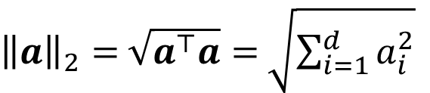
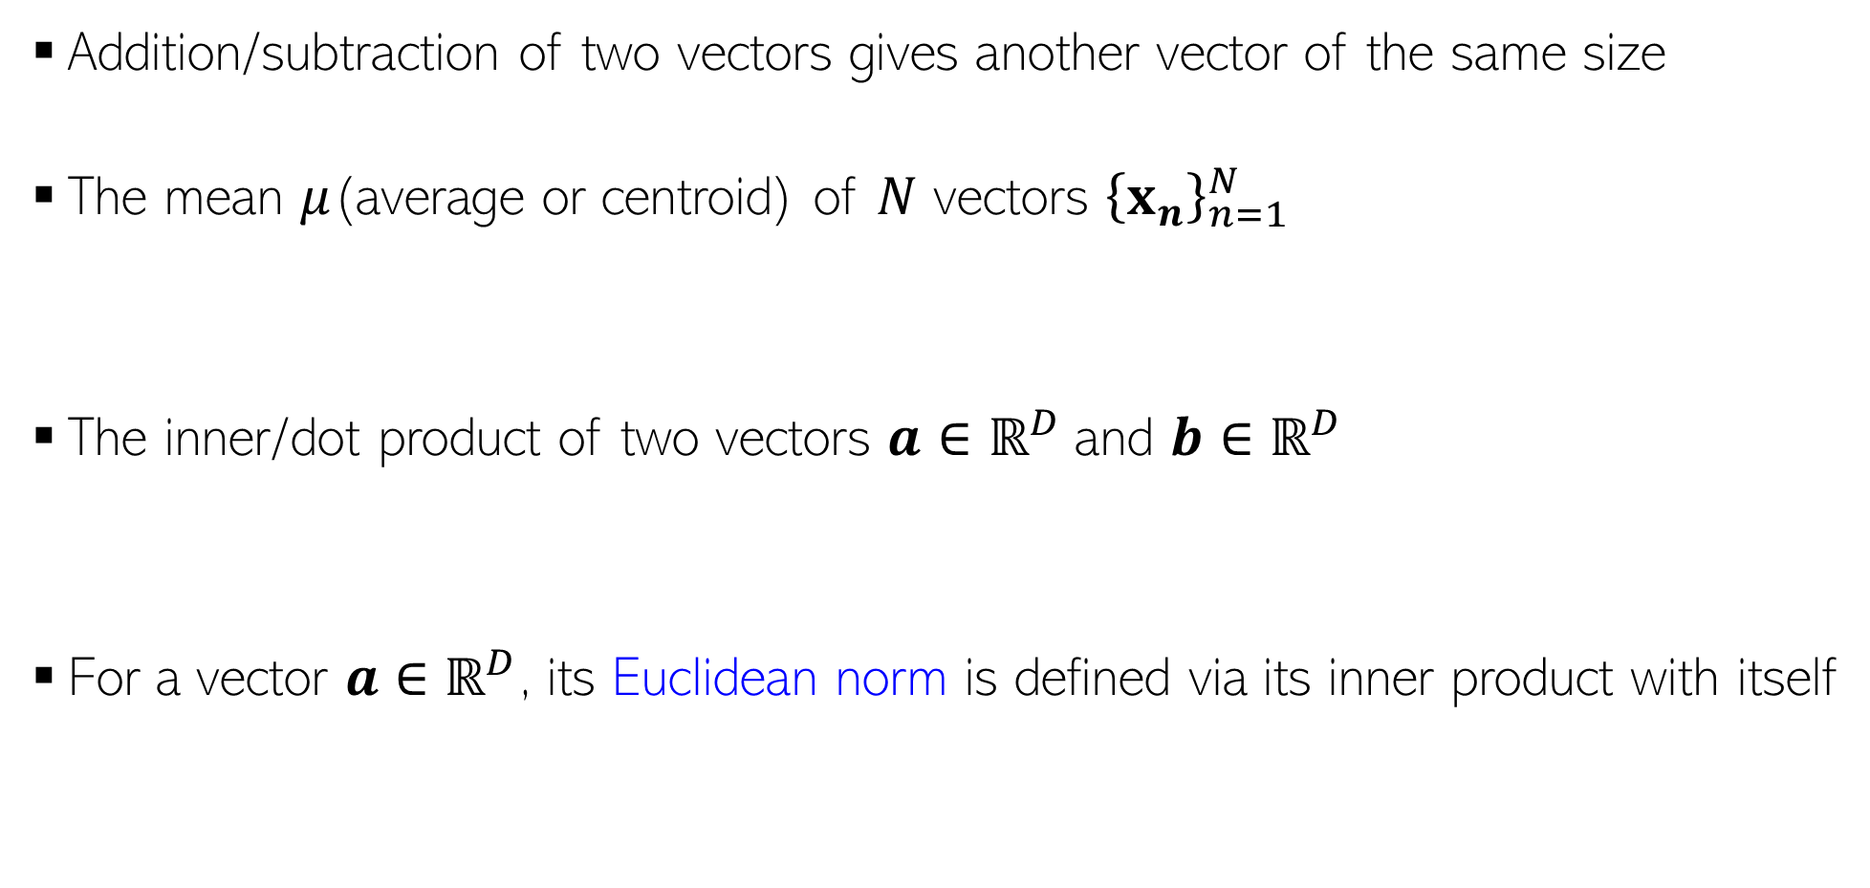
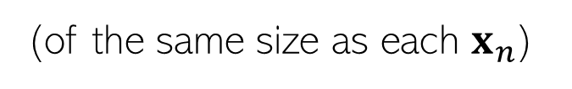

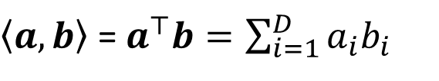

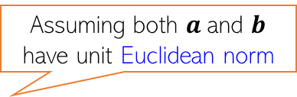
Some Basic Operations on Vectors
Addition/subtraction of two vectors gives another vector of the same size
The mean $μ$(average or centroid) of $N$ vectors ${\left\{x_{n}\right\}}_{n=1}^{N}$
The inner/dot product of two vectors $a$ $∈ℝ^{D}$and $b$ $∈ℝ^{D}$
For a vector $a$ $∈ℝ^{D}$, its Euclidean norm is defined via its inner product with itself
$$μ= \frac{1}{N}\sum_{n=1}^{N}{x_{n}}$$
(of the same size as each $x_{n}$)
Assuming both $a$and $b$ have unit Euclidean norm
$\left\langle a,b\right\rangle$ = $a^{⊤}b=\sum_{i=1}^{D}{a_{i}b_{i}}$
(a real-valued number denoting how “similar” $a$and $b$are)
${\left\|a\right\|}_{2}=$ $\sqrt{a^{⊤}a}=$ $\sqrt{\sum_{i=1}^{d}{a_{i}^{2}}}$
Also the Euclidean distance of $a$ from origin
Note: Euclidean norm is also called L2 norm

Slide 16

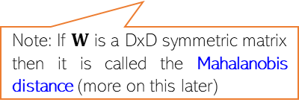

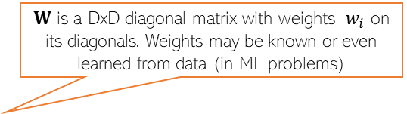
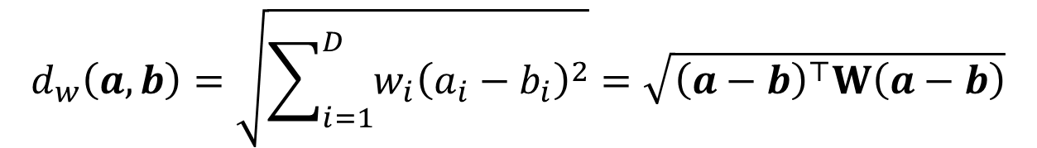
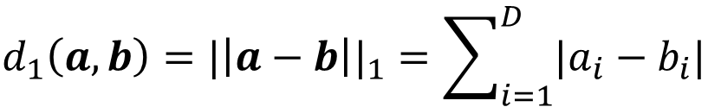
Computing Distances
Euclidean (L2 norm) distance between two vectors $a$ $∈ℝ^{D}$and $b$ $∈ℝ^{D}$
Weighted Euclidean distance between two vectors $a$ $∈ℝ^{D}$and $b$ $∈ℝ^{D}$
Absolute (L1 norm) distance between two vectors $a$ $∈ℝ^{D}$and $b$ $∈ℝ^{D}$
Sqrt of Inner product of the difference vector!
Another expression in terms of inner products of individual vectors
$$d_{2}\left(a,b\right)={|\left|a−b\right||}_{2}=\sqrt{\sum_{i=1}^{D}{{\left(a_{i}−b_{i}\right)}^{2}}}=\sqrt{{\left(a−b\right)}^{⊤}\left(a−b\right)}=\sqrt{a^{⊤}a+b^{⊤}b−2a^{⊤}b}$$
Useful tip: Can achieve the effect of feature scaling by using weighted Euclidean distances!
$W$ is a DxD diagonal matrix with weights $w_{i}$ on its diagonals. Weights may be known or even learned from data (in ML problems)
$$d_{w}\left(a,b\right)=\sqrt{\sum_{i=1}^{D}{{w_{i}\left(a_{i}−b_{i}\right)}^{2}}}=\sqrt{{\left(a−b\right)}^{⊤}W\left(a−b\right)}$$
Note: If $W$ is a DxD symmetric matrix then it is called the Mahalanobis distance (more on this later)
L1 norm distance is also known as the Manhattan distance or Taxicab norm
(it’s a very natural notion of distance between two points in some vector space)
Apart from L2 and L1. there other ways of defining distances?
$$d_{1}\left(a,b\right)={|\left|a−b\right||}_{1}=\sum_{i=1}^{D}{|a_{i}−b_{i}|}$$
Yes. Another, although less commonly used, distance is the L-infinity distance (equals to max of abs-value of element-wise difference between two vectors

Slide 17
Our First Supervised Learner

Slide 18
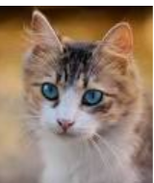
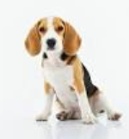
Prelude: A Very Primitive Classifier
The idea also applies to multi-class classification: Use one image per class, and predict label based on the distances of the test image from all such images
Consider a binary classification problem – cat vs dog
Assume training data with just 2 images – one and one
Given a new test image (cat/dog), how do we predict its label?
A simple idea: Predict using its distance from each of the 2 training images
d( , ) < d( , ) ? Predict cat else dog
Test
image
Test
image
Wait. Is it ML? Seems to be like just a simple “rule”. Where is the “learning” part in this?
Some possibilities: Use a feature learning/selection algorithm to extract features, and use a Mahalanobis distance where you learn the W matrix (instead of using a predefined W), using “distance metric learning” techniques
Excellent question! Glad you asked!
Even this simple model can be learned. For example, for the feature extraction/selection part and/or for the distance computation part

Slide 19
Improving Our Primitive Classifier
Just one input per class may not sufficiently capture variations in a class
A natural improvement can be by using more inputs per class
We will consider two approaches to do this
Learning with Prototypes (LwP), also called “Nearest Class Mean” (NCM)
Nearest Neighbors (NN – not “neural networks”, at least not for now ☺)
Both LwP and NN will use multiple inputs per class but in different ways
“cat”
“dog”
“cat”
“dog”
“cat”
“dog”

Slide 20
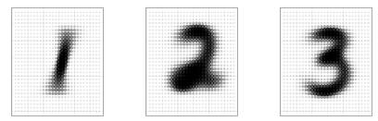
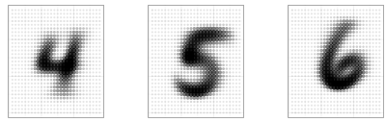

Learning with Prototypes (LwP)
Basic idea: Represent each class by a “prototype” vector
Class Prototype: The “mean” or “average” of inputs from that class
Predict label of each test input based on its distances from the class prototypes
Predicted label will be the class that is the closest to the test input
How we compute distances can have an effect on the accuracy of this model (may need to try Euclidean, weight Euclidean, Mahalanobis, or something else)
Averages (prototypes) of each of the handwritten digits 1-9
Pic from: https://www.reddit.com/r/dataisbeautiful/comments/3wgbv9/average_handwritten_digit_oc/

Slide 21





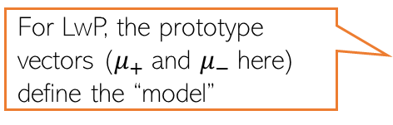
Learning with Prototypes (LwP): An Illustration
Suppose the task is binary classification (two classes assumed pos and neg)
Training data: $N$ labelled examples ${\{\left(x_{n},y_{n}\right)\}}_{n=1}^{N}$,${ x}_{n}∈ℝ^{D}$, ${ y}_{n} ∈\{−1,+1\}$
Assume $N_{+}$ example from positive class, $N_{−}$ examples from negative class
Assume green is positive and red is negative
$$μ_{−}= \frac{1}{N_{−}}\sum_{y_{n}=−1}{x_{n}}$$
$$μ_{+}= \frac{1}{N_{+}}\sum_{y_{n}=+1}{x_{n}}$$
$$μ_{−}$$
$$μ_{+}$$
LwP straightforwardly generalizes to more than 2 classes as well (multi-class classification) – K prototypes for K classes
For LwP, the prototype vectors ($μ_{+}$and $μ_{−}$here) define the “model”
Test example
Test example

Slide 22



LwP: The Prediction Rule, Mathematically
What does the prediction rule for LwP look like mathematically?
Assume we are using Euclidean distances here
$${\left|\left|μ_{−}−x\right|\right|}^{2}={\left|\left|μ_{−}\right|\right|}^{2}+{\left|\left|x\right|\right|}^{2}−2\left\langle μ_{−},x\right\rangle$$
$$μ_{−}$$
$$μ_{+}$$
$${\left|\left|μ_{+}−x\right|\right|}^{2}={\left|\left|μ_{+}\right|\right|}^{2}+{\left|\left|x\right|\right|}^{2}−2\left\langle μ_{+},x\right\rangle$$
Test example $x$
Prediction Rule: Predict label as +1 if $f\left(x\right)={\left|\left|μ_{−}−x\right|\right|}^{2}$ $−$ ${\left|\left|μ_{+}−x\right|\right|}^{2}>0$ otherwise -1

Slide 23

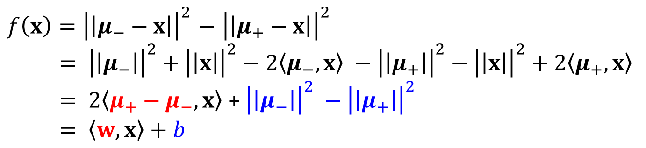
LwP: The Prediction Rule, Mathematically
Let’s expand the prediction rule expression a bit more
Thus LwP with Euclidean distance is equivalent to a linear model with
Weight vector $w=$2($μ_{+}−μ_{−})$
Bias term $b={\left|\left|μ_{−}\right|\right|}^{2} −{\left|\left|μ_{+}\right|\right|}^{2}$
Prediction rule therefore is: Predict +1 if $\left\langle w,x\right\rangle +b$ > 0, else predict -1
$f\left(x\right)={\left|\left|μ_{−}−x\right|\right|}^{2}$ $−$ ${\left|\left|μ_{+}−x\right|\right|}^{2}$
$= {\left|\left|μ_{−}\right|\right|}^{2}+{\left|\left|x\right|\right|}^{2}−2\left\langle μ_{−},x\right\rangle −{\left|\left|μ_{+}\right|\right|}^{2}−{\left|\left|x\right|\right|}^{2}+2\left\langle μ_{+},x\right\rangle$
$= 2\left\langle μ_{+}−μ_{−},x\right\rangle$ + ${\left|\left|μ_{−}\right|\right|}^{2} −{\left|\left|μ_{+}\right|\right|}^{2}$
$= \left\langle w,x\right\rangle +b$
Will look at linear models more formally and in more detail later

Slide 24



LwP: Some Failure Cases
Here is a case where LwP with Euclidean distance may not work well
In general, if classes are not equisized and spherical, LwP with Euclidean distance will usually not work well (but improvements possible; will discuss later)
Can use feature scaling or use Mahalanobis distance to handle such cases (will discuss this in the next lecture)
$$μ_{−}$$
$$μ_{+}$$
Test example $x$

Slide 25
LwP: Some Key Aspects
Very simple, interpretable, and lightweight model
Just requires computing and storing the class prototype vectors
Works with any number of classes (thus for multi-class classification as well)
Can be generalized in various ways to improve it further, e.g.,
Modeling each class by a probability distribution rather than just a prototype vector
Using distances other than the standard Euclidean distance (e.g., Mahalanobis)
With a learned distance function, can work very well even with very few examples from each class (used in some “few-shot learning” models nowadays – if interested, please refer to “Prototypical Networks for Few-shot Learning”)
How well LwP works depends crucially on the way we compute distances

Slide 26
Next Class
Nearest Neighbors
Decision Trees and Forests/Ensembles

